Slide 1
A Viaticum for “Last-Chance IT Consultants” (S126)
was: Translatability, Context, Complexity: Migration of Dependable Systems
Gérard Calliet pia-sofer

Slide 2
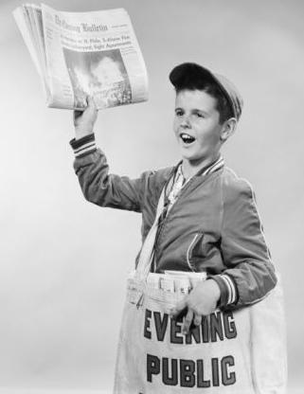
Introduction: The Program Has Changed
Before July 31st, the question was: We have fundamental reasons to organize an ordered retreat; how do we proceed?
After July 31st, the question became: On what foundations should our future be affirmed and organized?
Or: Why did we survive?
And then: On what foundations should we base ourselves?

Slide 3
Introduction: Meta-Methodology
We determine theoretical and pragmatic specificities for our specific situation.
We determine how to situate ourselves within a bigger context.
Knowing what is possible and what is not, we are able to make decisions about what we want.
Knowing where we want to go, we can determine how to get there.

Slide 4
Introduction: Non-Purpose of the Presentation
It is not about tools.
It is not about translation sciences.
It is not about IT methodology.
It is about how solid foundations help us in our endeavors.

Slide 5
Agenda
Part I: Where are we?
Part II: Where do we go?
Part III: How do we get there?
Pierre Dac: à la question qui suis-je, d'où viens-je où vais-je je réponds je suis moi, je viens de chez moi et j'y retourne
(“To the question of who I am, where I come from and where I am going, I would answer, I am me, I come from my home, and I am going back there”)

Slide 6
Part I: Where are we? (contents)
A Trowel in Babel: IT sciences and idioms.
Achilles in Babylon: Complexity, replication, correlation.
Are there "last-chance handlers” in a world of general misunderstanding?

Slide 7
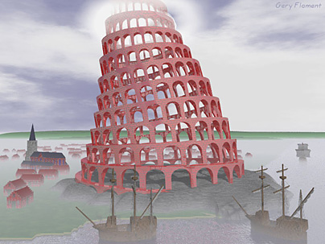
A Trowel in Babel: The Story
There was one language for the whole world
But then dialects appeared

Slide 8

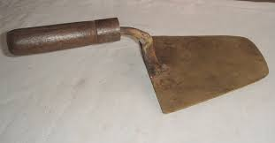
A Trowel in Babel: The Story
He would receive a shovel
And when a mason asked for a trowel

Slide 9
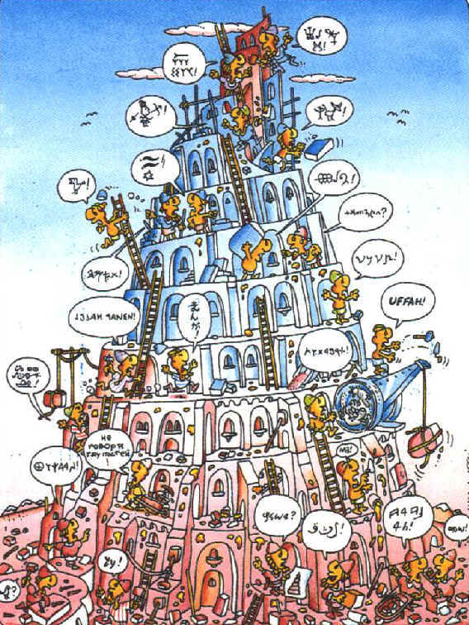
A Trowel in Babel: The Story
And so the building of the tower was interrupted

Slide 10
Lost in Translation
Story of Philosophy:
  It begins with Plato and Aristotle struggling for unequivocal naming.
  As a result, we are able to think the right way about science.
  We now come to Heidegger, Wittgenstein, and some French thinkers, all heirs of Plato’s and Aristotle’s efforts, and hyper-critical of their results.
Summary: Every theory about the world is only a specific, rationalized fiction.

Slide 11
Lost in Translation
Story of Mathematics:
  Euclide : “Our world is Euclidian”
  Riemann : “Another world is possible”
  Godel : “Pure unequivocal formal system is impossible”
Summary: Even formal languages cannot reference with certainty a unified realm.

Slide 12
Lost in Translation
Linguistics:
  Systemic : A language is a system of relative differences
  Pragmatic : A language cannot be fully understood if isolated from its communicative context
  Automatized Natural Language Translation: Impossible without some contextual statistics
Summary : Total translation should not be seen as an attainable goal, but instead as a limit.

Slide 13
Idiom
Idiom = total translation – possible translation
Idioms = what remains impossible to translate
Example :
  “force de loi” versus “enforce the law”
  You need all of French culture and all of American culture to understand the difference and be able to “translate.”
  You need to be American and you need to be French.

Slide 14
IT Idioms
A program is a theory about a functional situation.
It “translates” the functional situation into a specific language (Ph.).
The specific language has its proper rules (S. Li.).
The language is categorized into procedural, functional, and logical paradigms (S. Li.).
It operates in a specific environment (P. Li.).
Summary : Everything is IT idioms; you have to be both 'VMS' and 'UNIX' to carry out an exact translation, which is formally impossible.

Slide 15
Examples of VMS Idioms
Everybody knows about:
  VMS processes
  DCL contexts
  AST uses...
All of these things are part of a cultural environment, and places for idiomatic programming.
Our customers “are stuck” with VMS: because of the benefits of its idioms.
And the huge intellectual effort it would take to “translate” what is formally impossible to translate.

Slide 16
Trade Skills versus ‘Business Tier’
Our softwares not only represent our functional requirements, they are our business.
We cannot remember what our job was like before its “translation” into programs.
Multi-tier architecture demonstrates a struggle to contain this reality.
But: Our advanced softwares often know our trade better than we do.
Summary: A program is a functional idiom.
Consequence : Re-engeniering is an in-depth task and you need to act like the initial programmer.

Slide 17
Times are Changing
Old idiomatic softwares are the '80s answer to important functional issues.
They are rich in meaning.
It is more important to understand them than to attempt to translate them.
Our choice: To maintain our understanding or to risk losing everything.
On the contrary: There is less and less understanding involved in the existing myriads of black boxes.

Slide 18
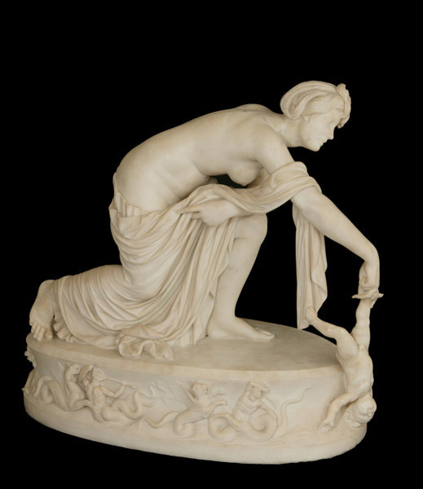
Achilles in Babylon: Complexity, Replication, Correlation
Everybody knows about Achilles' heel and the meaning of the story

Slide 19
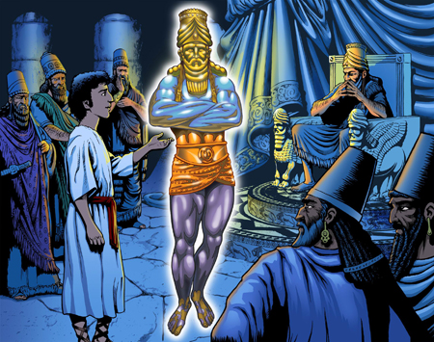
Achilles in Babylon
There is a similar story in the Book of Daniel: the statue with feet of clay.
- Our computer world is huge, powerful... and breakable.
- And, like the king of Babylon, we are somehow aware of this weakness; sometimes we have bad dreams.
- Today’s version would be Mr. Randy Meyer asking Mr. Duane P. Harris about a bad dream.

Slide 20
Complexity: Black Boxes or Bad Boxes?
Modularization is good.
But the myriad of “useful” black boxes is a trap.
No time to read the manual.
No thinking about side-effects.
Loss of security, loss of safety.

Slide 21
Replication is not sufficient for safety
Replication is not sufficient for safety.
We have huge resources.
We imagine we can use them to replicate everything,
And that we will be safe.
But 1000 * 0 = 0

Slide 22
Correlation Versus Logic
“Big Data” epistemic revolution seems to be about correlation replacing logic.
Pertinence to a lot of things: business, empirical results as first steps to scientific results (in health care, for example), NSA knowledge of the world...
Can be a threat to our intelligence: statistics don't prove anything, the “bad” could in some situations be more frequent than the ‘good’.
Somewhere there remains a need for logic: even statistics need the right calculations.

Slide 23
Where could we be wrong?
The common axiom between:
  Universal black-boxing
  Blind confidence in replication
  Acceptance of truth from correlation
Faith in a possible completely unified world, a single-language world.
  Black-boxing: Everything can be understood and associated with everything.
  Replication: Association is sufficient for secure building.
  Correlation: If everybody thinks the same thing, it is true.

Slide 24
Why did VMS survive?
Necessity of diversity
Strong typing in VMS: unequivocal DCL…
Diversity within VMS: Common Language Environment...
VMS softwares are not black boxes capable of doing anything, but good, idiomatic softwares

Slide 25
Where We Are: Conclusion
The risk of the current phase of IT science:
  Building blindly, using a huge number of black boxes, whose functioning we are not even able to fully understand:
    'I neither know the ins nor the outs, I can only garantee a statistical safety'
Do “last-chance handlers” exist somewhere in the world?
Dependable systems are “last-chance handlers.”

Slide 26
Where We Are: Conclusion
Our specific work:
  To guarantee the future of dependable systems
  To define their life cycle, their relative position in the general IT world

Slide 27
Part II: Where We Go (contents)
The Big Picture: Alliance of Globality and Uniqueness
Transparent Sustainable Boxes
Chains of TSB, Contracts
Galactic Rhythms: Where sustainability structures space

Slide 28


Clouds are Global Spaces
The Infinite Recognition
Inversed Cloud

Slide 29

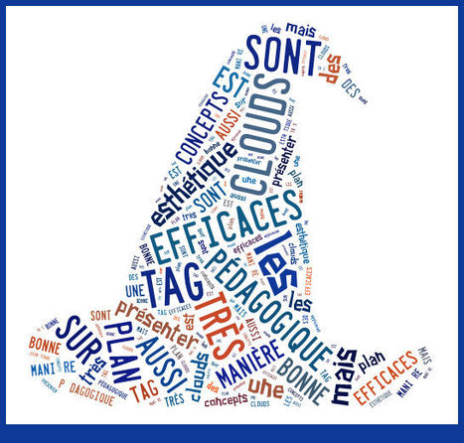
Clouds are made of words

Slide 30
Globality and Uniqueness
Globality is good.
But absolute globality is an unattainable and dangerous dream.
Uniqueness and precision of idiomatic software is good.
But the essential difficulty of translation makes uniqueness feel like an obstacle.
On one hand, we dream of more uniqueness, and on the other, of less.

Slide 31
Alliance of Globality and Uniqueness
If we are reasonable enough to restrain our unattainable dreams, we can ally:
  Useful Globality, knowing it will never be completely coherent and safe.
  And Unique pieces of software, reliable and better understood, knowing we will never be capable of making them completely universal.

Slide 32
Unique (VMS) places: Sustainable Boxes
It is important to:
  Determine precise segments of software that do exactly one thing.
  Understand their pure specificities:
    Meaning (what do they do, what function they “translate”)
    Systemic idioms (language, architecture, data...)
    Systemic contexts (relations with DCL, RTL, System Services, VMS idioms like AST...)
  Be able to describe all these specificities.

Slide 33
Unique (VMS) Sites: Chains of Transparent Sustainable Boxes
If we know sustainable boxes well, we can write contracts about them.
It is the heart of SOA: Programming by contracts (B. Meyer).
  It is not necessary to be fully SOA compliant, because
  We don't think that everything is a service.
The focus is on being able to trust sequences of TSB.

Slide 34

Galactic Rhythms
The unified, cloudy world is similar to space-time.
There is a curvature of space-time that depends on specific, large-scale objects in it.

Slide 35

Galactic Rhythms
IT sytems do not exist in untouched, anonymous space.
They structure general IT space through their qualities.

Slide 36
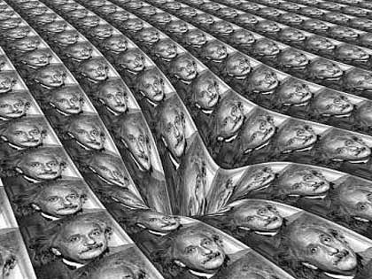
Galactic Rhythms
A good IT galaxy is one where chains of TSBs structure their neighborghood.
Dependable systems are unique and provide safety for the unified IT world.
Center of business critical would be VMS sites.
Center of cloudy galaxies would be Clusters.

Slide 37
Part III: How to Get There? (contents)
What is it all about? Fundamentals, Quality, Transmission.
  The answer is to renew IT studies.
What is urgent?
  To have well-defined specific tasks.
What will the future be like?
  The “last-chance consultants” from underground to new alliances.

Slide 38
The Importance of IT Foundations
From the same roots, IT science:
  Was founded (result of impossibility to establish the foundations of mathematics)
  Began to be useful (in DEC labs with MIT people)
  Is now evolving (introduction of functional paradigm into javascript)

Slide 39
The Importance of Quality
Refined understanding of programs and execution environments involves an advanced level of science.
Idiomatics are now recognized as a need (DSL languages, for example).
There is no translation available without prior Refactoring (M. Fowler).
A contract has to be exact, and it is a demanding task (B. Meyer).

Slide 40
The Importance of Transmission
The founders’ work is extremely interesting.
Studying what they have invented is a compelling task.

Slide 41
Answer I: To renew IT Studies
We have to create curriculum concerning all of this.
  A type of “university” for dependable and sustainable systems
    It can only exist if we are able to sell it to young people.
    This presentation contains some key arguments for its existence.

Slide 42
Answer II: Well Defined Tasks
VMS consulting is a precise art for precise tasks.
We must be able to:
  Maintain VMS systems with their specific needs.
  Expose precisely what VMS boxes do.
  Understand how VMS boxes do what they are doing.
  Reorganize VMS sites into trustable chains of trustable boxes.

Slide 43
Answer III: From Underground to New Alliances
The global IT world has always been dependent on unknown “last-chance handlers.”
VMS revival indicates that the need for sustainable, unequivocal, safe pieces of software is becoming more widely acknowledged.
The next step is to create new alliances between foreground and background ecosystems.
This will be possible if every actor is able to expose its specific qualities and knows about its limitations.

Slide 44
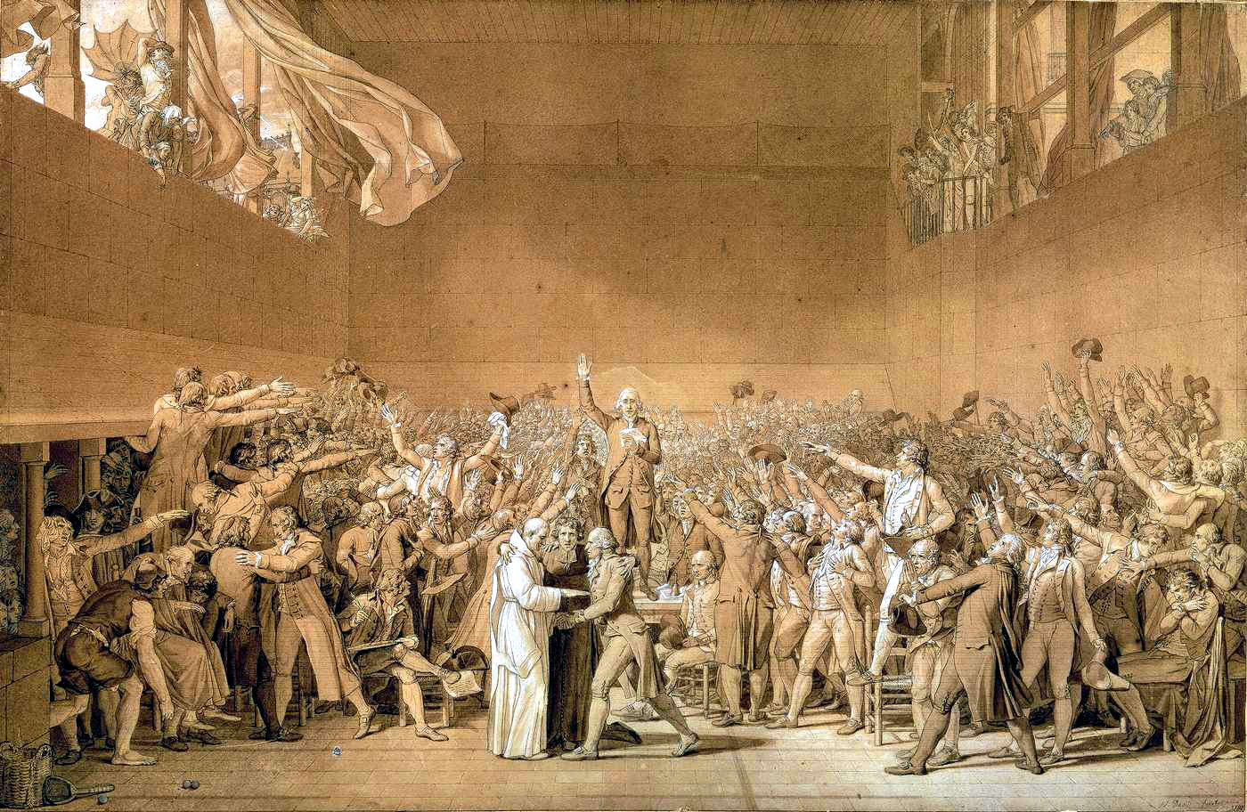
Debate

Slide 45
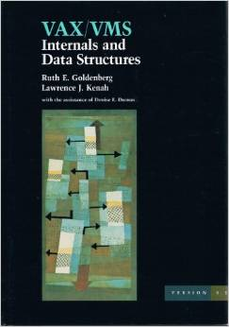
References, Bibliography, Links
The book:
VAX/VMS Internals and Data Structures
Ruth Goldengberg
Lawrence Kenah

Slide 46
References, Bibliography, Links
Bible Genesis 11 1-9
Bible Daniel 2
Architecture-Driven Modernization (OMG)
http://www.omg.org/adm/
Information Systems Transformation William M. Ulrich Philip H. Newcomb (Morgan Kaufmann)
Philosophical struggles about unequivocal sciences, the titles are beautiful
http://en.wikipedia.org/wiki/Categories_(Aristotle)
http://en.wikipedia.org/wiki/The_Crisis_of_European_Sciences_and_Transcendental_Phenomenology

Slide 47
References, Bibliography, Links
Logic, Mathematics, Programs
http://www.emis.de/classics/Riemann/WKCGeom.pdf
http://www.paultaylor.eu/stable/prot.pdf
Logique et fondements de l’informatique Richard Lassaigne Michel de Rougemont (Hermes)
http://palmstroem.blogspot.fr/2012/05/lambda-calculus-for-absolute-dummies.html
Types and Programming Languages Benjamin C. Pierre (MIT Press)

Slide 48
References, Bibliography, Links
Idioms
(Enforce the law, french reading)
http://repository.uwc.ac.za/xmlui/bitstream/handle/10566/302/DeVilleForceofLaw2009.pdf?sequence=4
Sky my husband Ciel mon mari Dictionnary of the running English Jean-Loup Chiflet (Points)
Translations
Speech and Language Recognition (Pearson International Edition)
The definitive ANTLR reference Building Domain-Specific Languages Terence Parr (The Pragmatic bookself)
Mastering Regular Expressions Jeffrey E.F. Friedl (O’Reilly)

Slide 49
References, Bibliography, Links
Refined programming
A touch of class Learning well to Program with Objects and Contracts Bertrand Meyer (Springer)
http://en.wikipedia.org/wiki/Design_by_contract
Refactoring Improving the Design of Existing Code Martin Fowler (Addison Wesley)
http://en.wikipedia.org/wiki/Domain-specific_language
Principes d’Implatation de Scheme et Lisp Christian Queinnec (Paracamplus)
Functional paradigm
http://en.wikipedia.org/wiki/Functional_programming
Programming in Scala Martin Odersky Lex Spoon Bill Venners (artima)
http://www.dummies.com/how-to/content/jquery-for-dummies-cheat-sheet.html

Slide 50
References, Bibliography, Links
Misuse of Black Boxes
https://medium.com/message/everything-is-broken-81e5f33a24e1
When I’m Sixty-Four
VMS Advanced Device Driver Techniques Jamie E. Hanrahan Lee Leahy (Professional Press)
https://www.youtube.com/watch?v=eCss0kZXeyE
Masterminds of Programming Conversations with the Creators of Major Programming Languages Federico Biancuzzi (O’Reilly)
Coders at Work: Reflections on the Craft of Programming Peter Seibel (Apress)

Slide 51
Thank You
Gérard Calliet pia-sofer sarl Paris France
www.pia-sofer.fr gerard.calliet@pia-sofer.fr
With the indispensable help of Auni Hovanesian, writer and translator
aunimichelle@gmail.com

